Slide 1
DO NOW: Welcome back! Your first “Do Now” is to complete the paper on your desk. If you finish early, write about or draw something you did this summer on the back.

Slide 2
About Ms. Sloan
I LOVE to:
Watch football and hockey
Draw and do crafts
Go to Target
Play with my puppy, Ziggy
Swim in pools
Eat chocolate, seafood, French fries, and hamburgers
Sleep in late
Read
Have campfires with friends and family

Slide 3
H O M E

Slide 4
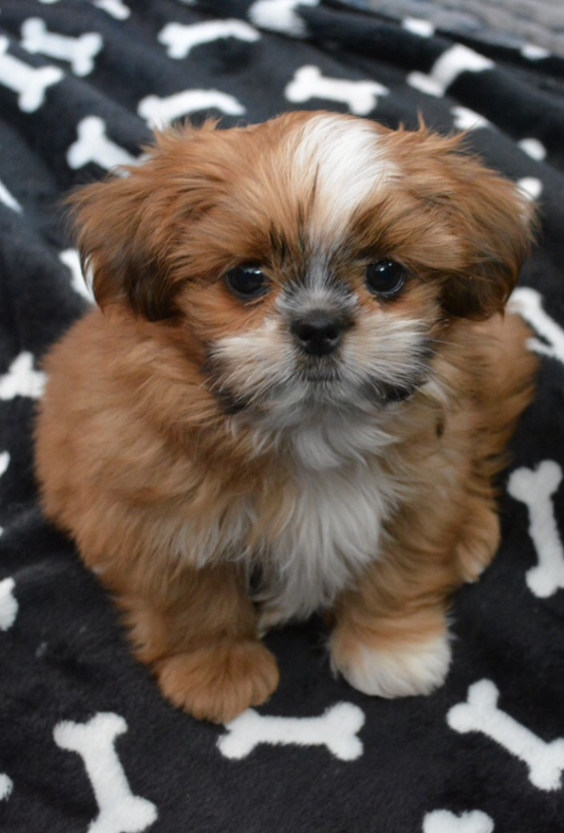
Ziggy

Slide 5
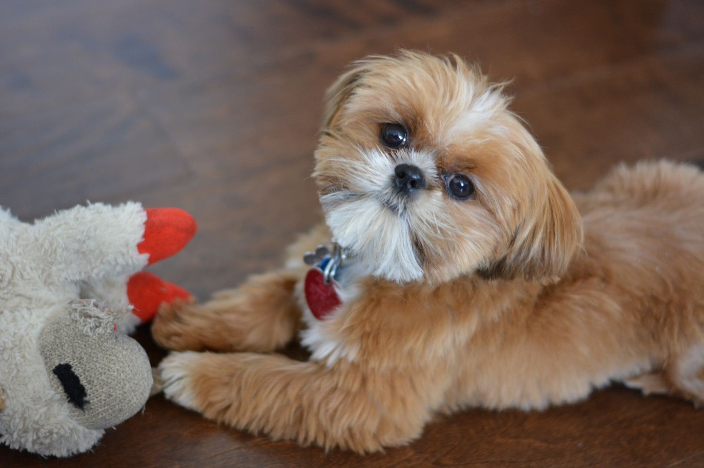

Slide 6
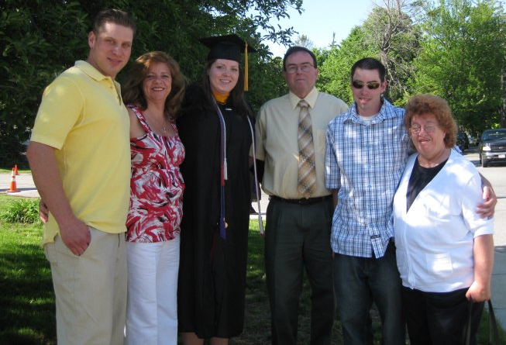
Family
Brother Tom, Mom, Me, Dad, Brother Adam, Grandma
Jason –My fiancé

Slide 7
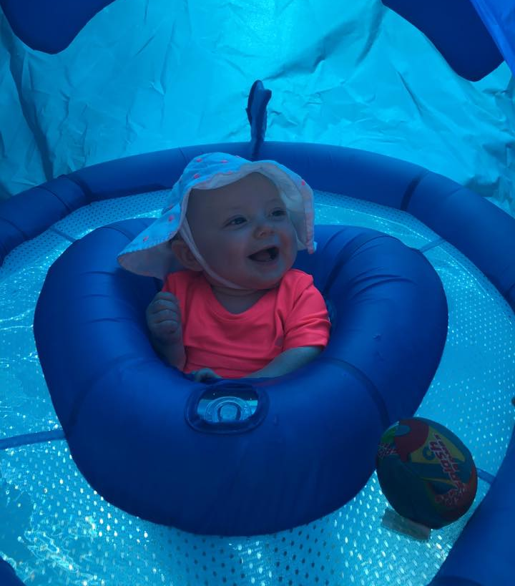
Family
Baby Hannah –My niece

Slide 8
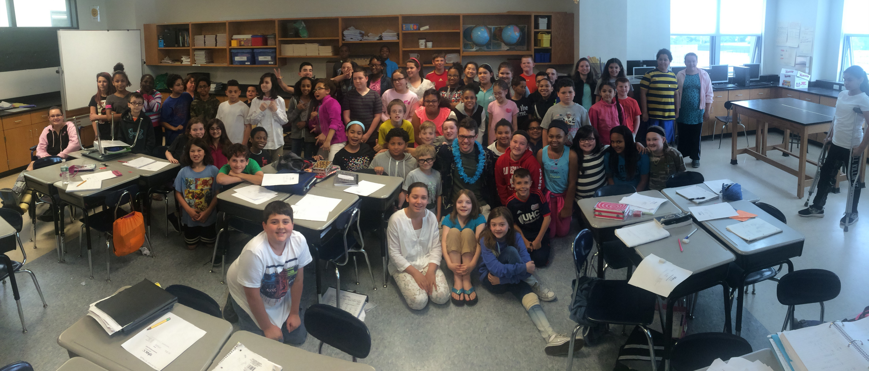
Former Students in Massachusetts

Slide 9
5th Grade Schedule:
Homeroom with Ms. Sloan in 308
SFA –Success for All (starting on September 5)
Encore for marking period 1
Monday Art
Tuesday Music
Wednesday Physical Education
Thursday Spanish
Friday Library
Math (with Ms. Sloan)
Science (with Ms. Sloan)
Lunch 12:30-1:00
ELA (with Mrs. Floyd)
Social Studies (with Mrs. Floyd)
Homeroom

Slide 10
6th Grade Schedule:
Homeroom with Mrs. Floyd in 305
SFA –Success for All (starting on September 5)
Encore for marking period 1
Monday Spanish
Tuesday Library
Wednesday Art
Thursday Music
Friday Physical Education
ELA (with Mrs. Floyd)
Social Studies (with Mrs. Floyd)
Lunch 12:40-1:10
Math (with Ms. Sloan)
Science (with Ms. Sloan)
Homeroom

Slide 11
Other 5th/6th Grade Teachers:
Ms. Sloan
room 308 math/science (5th grade homeroom)
Ms. Floyd
room 305 ELA/social studies (6th grade homeroom)
Ms. Fogelman
room 303 math/science (5th grade homeroom)
Mrs. Spady
room 304 ELA/social studies (6th grade homeroom)
Mrs. Ort
room 301 math/science (5th grade homeroom)
Ms. Ritson
room 306 ELA/social studies (6th grade homeroom)

Slide 12
Expectations:
Bearcat PRIDE
Participate
Try your best
Not interrupt the learning of yourself or others
Dress code
Cell phones
Bathroom

